Slide 1

‘Rate cuts, structural transition and a low visibility global economy’
January 2025

Slide 2
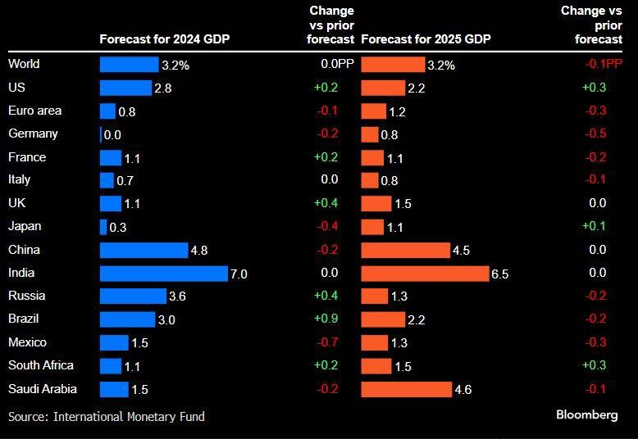
World economy: IMF GDP forecasts – October 2024
2
Proprietary business information of ADM.
2024 GDP stronger than many had expected & surveys have implied, even China & Eurozone.
Despite tensions, global real trade growth also proving robust.

Slide 3
World economy: key factors
3
Proprietary business information of ADM.
World economy in big transition due to short, medium & long-term factors, but VUCA (Volatility, Uncertainty, Complexity & Ambiguity) remains the watchword in outlook terms, i.e. lack of pre-pandemic ‘visibility’
Uncertainty weighs on economic surveys, but also demands greater agility, adaptability, risk awareness & strengthening existing business relationships
Supply chains are and will remain vulnerable to trade tensions, war, weather / climate events, concentration risks and regulatory interventions
But this is not deglobalization, but re-globalization or re-routing; just take a closer look at how EU trade with Russia has not stopped due to sanctions
Geopolitics: Trump 2.0 touting ‘peace’ in Ukraine and Middle East, but also ramping up trade tariffs; IRA will be amended; deregulation moves in focus
Energy Transition and AI boom are both inflationary; in contrast to technology boom to date are also both very capital intensive, and will make heavy demands on power grids that are not fit for purpose anywhere
Labour skills shortages continue to speed up automation and digitalization

Slide 4
International and regional/national factors
4
Proprietary business information of ADM.
US economy boosted by fiscal spending, IRA and CHIPS acts, cheap energy, tech sector leadership; debt growth not sustainable, and now …Trump 2.0
China: jury still out on latest stimulus, transformation from investment to consumption led economy not getting traction; over capacity threat to margins and risk of deflation; but way ahead on energy transition technology
Asia: divide appearing between countries with China dependency, and those at the heart of AI/Tech boom, but region is still the engine of world growth
Eurozone: political paralysis, failure to agree EU reforms, energy and inflation shocks a body blow to competitiveness, squeezed by US and China policies
India: infrastructure, services exports boom; Brazil resource led boom; both are aided by ‘de-risking’, but capacity constraints an increasing headwind
GCC: major capital inflows, ambitious plans, huge optimism, but oil prices a problem, and obvious risks from Israel / Gaza conflict & Syrian ‘revolution’

Slide 5
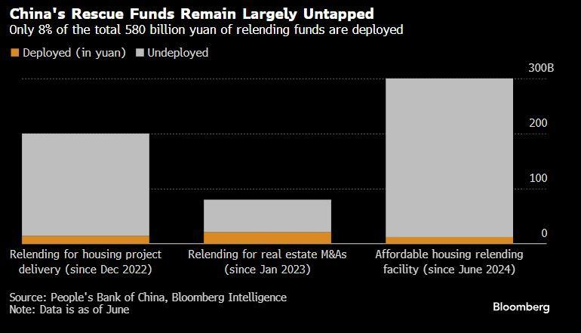
China: 2022-24 Property Rescue Fund Deployment
5
Proprietary business information of ADM.
Not easy to deleverage a $50 Trillion (?) property bubble, and even more difficult when 68% of personal savings are in real estate

Slide 6
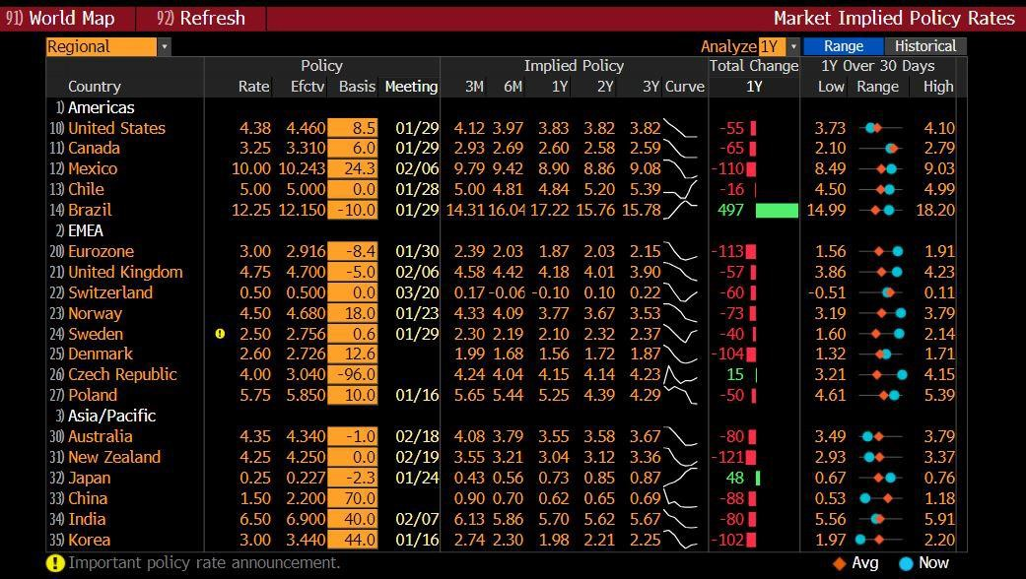
Pendulum has swung from rate hikes to cuts…
6
Proprietary business information of ADM.
Rate cuts have been mostly gradual to start with, expectations very fluid.
NB: first rate cut cycle not triggered by a crisis for >20 years!

Slide 7
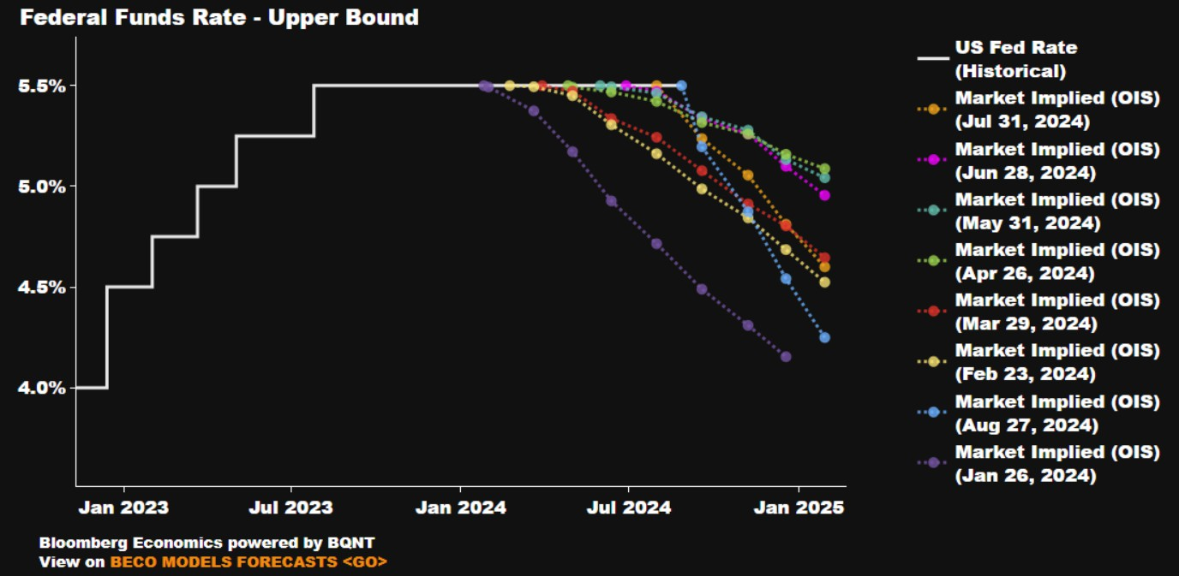
Market US Fed Rate Cut Expectations….. Hmmm!
7
Proprietary business information of ADM.
Illustrates how market rate expectations are both fickle and fluid, and
quite often misguided (“wishful seeing”)…. and not just in the US

Slide 8
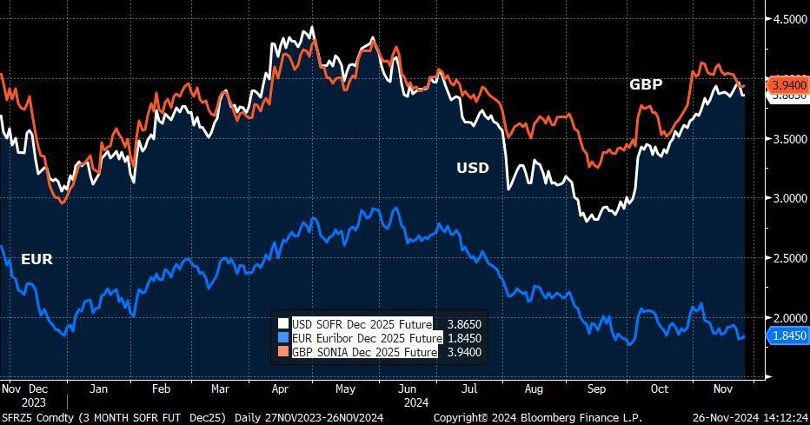
Rollercoaster ride of Fed, ECB & BoE rate expectations
8
Proprietary business information of ADM.
Divergence of EUR and USD & rate expectations in Q4, and indeed GBP underlines why the Euro has been so weak

Slide 9
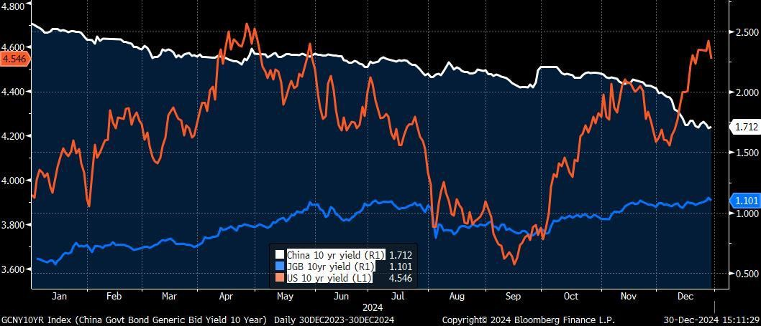
Divergences: China vs. Japan vs. US 10-yr yields
9
Proprietary business information of ADM.
Convergence of China and Japan yields cannot be ignored, nor their general insensitivity to the volatility of US 10-yr yields

Slide 10
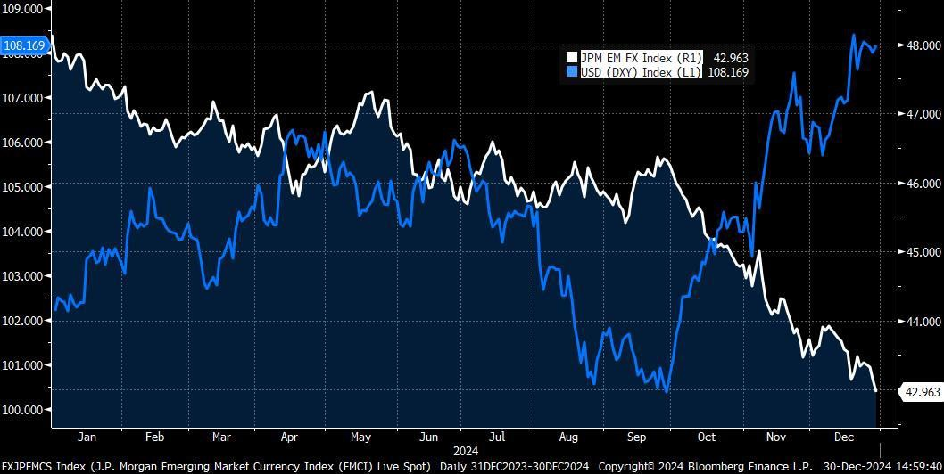
Divergences: USD strength and JPM EM FX index slide
10
Proprietary business information of ADM.
USD index a reflection of fickle and fluid Fed rate expectations, while EM FX has suffered both due to USD strength, and Trump 2.0 fear

Slide 11
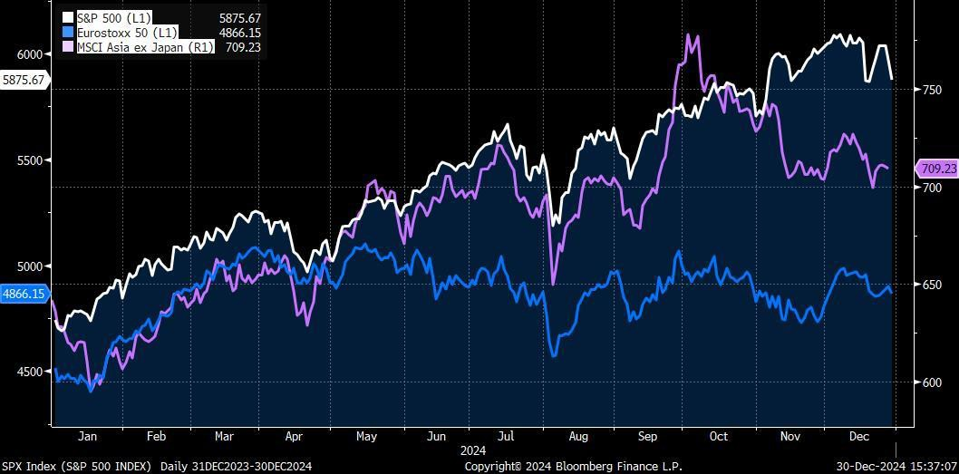
Divergences: S&P500 vs. MSCI Asia & Eurostoxx 50
11
Proprietary business information of ADM.
Divergence after Q1 2024, initially Europe, but latterly Asia - Europe may be fairly priced, US looks overvalued, Asia to stay choppy?

Slide 12
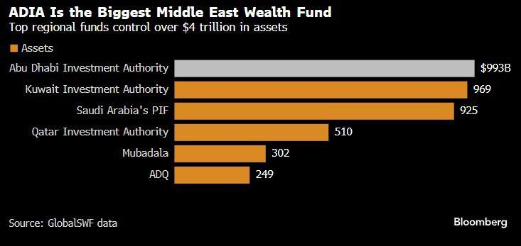
Money talks: GCC Sovereign Wealth Fund Assets
12
Proprietary business information of ADM.
The financial ‘fire power’ of the GCC wealth funds simply cannot be ignored

Slide 13
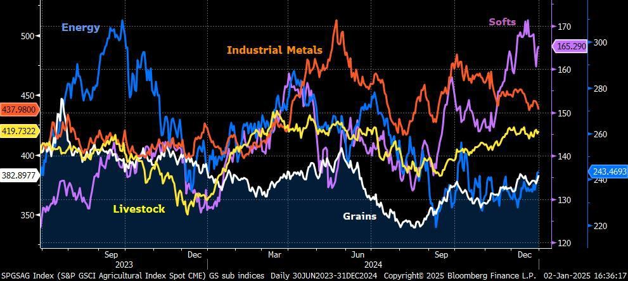
Commodities: Energy & Grains boo! Softs hooray!
13
Proprietary business information of ADM.
GS Commodity Index sub-sector indices

Slide 14
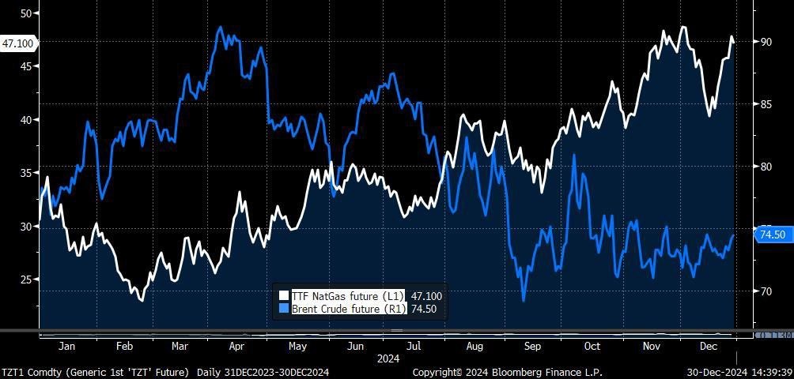
Divergences: Brent Crude vs. TTF Europe Gas
14
Proprietary business information of ADM.
Peak Oil demand, but a very different story for NatGas

Slide 15
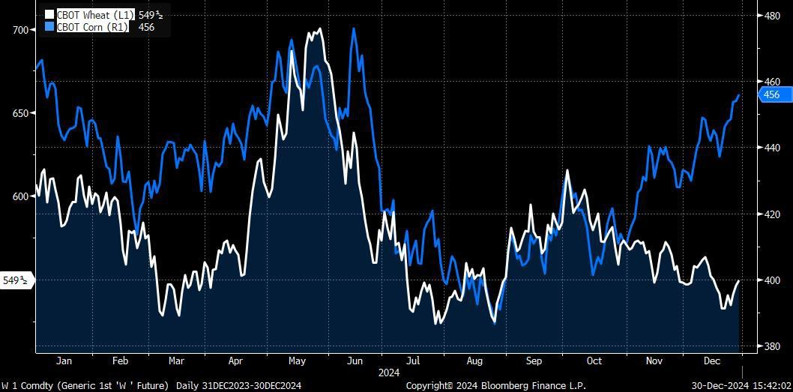
Divergences: CBOT Corn vs. Wheat
15
Proprietary business information of ADM.
Mid-year correlation gives way to Q4 divergence

Slide 16
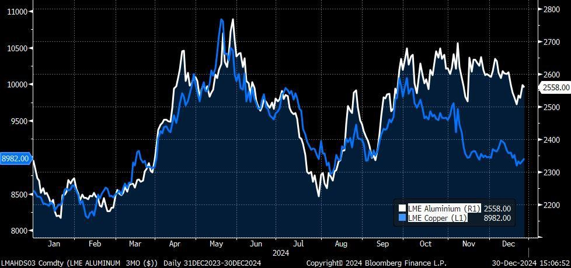
Divergences: LME Aluminium vs. Copper
16
Proprietary business information of ADM.
China clearly an influence, especially with talk of Copper being substituted for Copper, but Alumina supply disruption also key

Slide 17
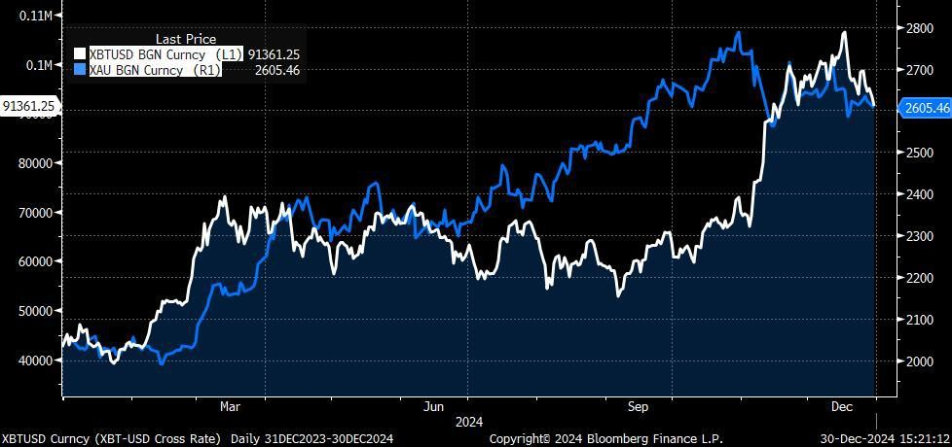
Gold vs. Bitcoin – as much out of step as in step
17
Proprietary business information of ADM.
No doubt about Trump factor being at work for Bitcoin, while Gold probably suffering as EM central banks intervened to prop up their currencies

Slide 18
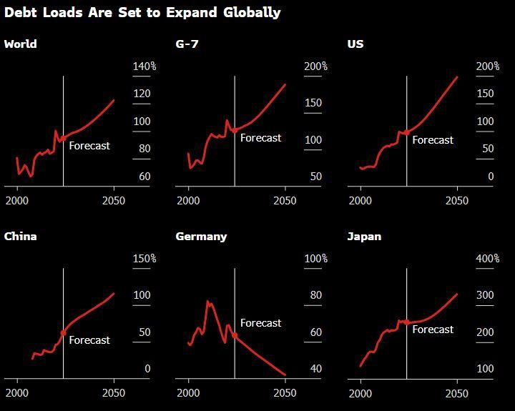
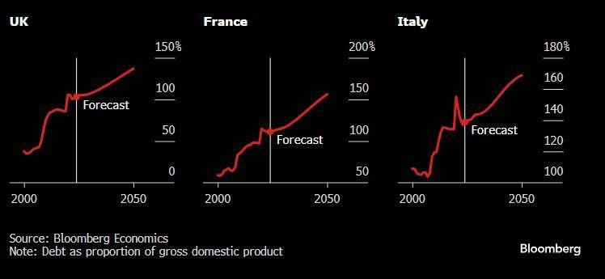
Global debt growth – not sustainable, except Germany
18
Proprietary business information of ADM.

Slide 19
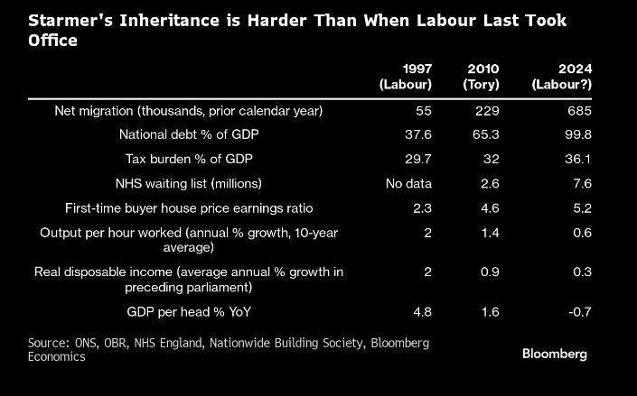
UK Economy Snapshot – 2024 vs. 2010 and 1997 –
What the Labour Party inherited in July
19
Proprietary business information of ADM.
- Marc Ostwald

Slide 20
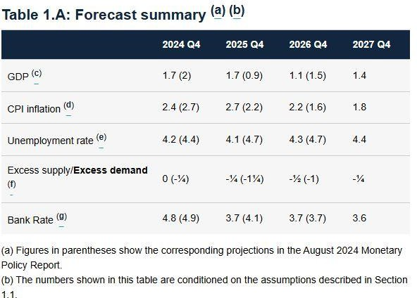
Bank of England UK Economic Forecast - Nov 2024
20
Proprietary business information of ADM.

Slide 21
UK’s primary economic challenges
21
Proprietary business information of ADM.
Brexit and political instability were adverse headwinds for investment, above all uncertainty about fiscal and legislative outlook, and ‘red tape’
Over dependence on imports of goods, above all in a world which is fracturing and bifurcating, … it is simply not a good time to be ‘going it alone’
High tax burden to GDP ratio, with very little relief in prospect post Budget
Labour skills shortages exacerbated both by Brexit, demographics as ‘baby boomers retire, low labour force participation, prohibitive cost of child care, poor trend in labour productivity since global financial crisis (GFC)
Erratic public sector infrastructure investment since WWII, austerity ‘dogma’
Growth in UK real wages has been negligible since GFC at just 0.2% y/y
UK financial sector ‘might’ fading, capital shifting to Asia and GCC
Agriculture suffering from poorly managed transition from EU CAP

Slide 22
UK’s post Budget challenges – Agri-food focus
22
Proprietary business information of ADM.
National Living Wage & National Minimum Wage – increased by 6.8%, brings total increase since 2019 to ca. 38%
Business Rates Relief for Retail and Hospitality: 75% discount in place since 2020 and capped at £110,000 per business, to be extended beyond April 2025, but only at a lower 40%
Agricultural Property Relief (APR): The 100% APR rate will be limited to a combined allowance of £1 million for Business and Agricultural Property assets. Above that the rate of relief reduced to 50%.
Govt to extend scope of APR to include environmental land management from April 6, 2025. This will provide relief for land managed under an agreement with the UK government, public bodies, or other approved bodies.
Phasing out direct payments to farmers – reduction of 76% for the first £30,000 of a payment in 2025. No payments will be made for any portion above £30,000.
Now bear in mind, according to DEFRA data published in September, average Farming return on capital employed was just 0.5%

Slide 23

Any questions to marc.ostwald@admisi.com
ADM ISI ‘The Ghost In The Machine’ current issue & archive:
https://admisi.com/customer-services/the-ghost-in-the-machine
We always welcome internal and external guest contributions!

